Slide 1

Stand Out and Speak Up!
2017 Pathfinder day sermon

Slide 2

For such a time as this
On January 15, 2009, US Airways flight 1549 took off from LaGuardia Airport in New York City. Suddenly after just a few minutes in flight the plane ran into a flock of Canadian Geese, some of which weighed 10 lbs.! Many of them were consumed into the plane’s engine and to the horror of passengers and pilots both engines were destroyed. If it were not for the quick thinking and expertize of Captain Sully, Flight 1549 and her passengers would have met a tragic fate. But Captain Sully was called “for such a time as this.” In what is known today as the “Miracle on the Hudson,” he amazingly landed the plane safely on the river and all lives on board were saved.

Slide 3
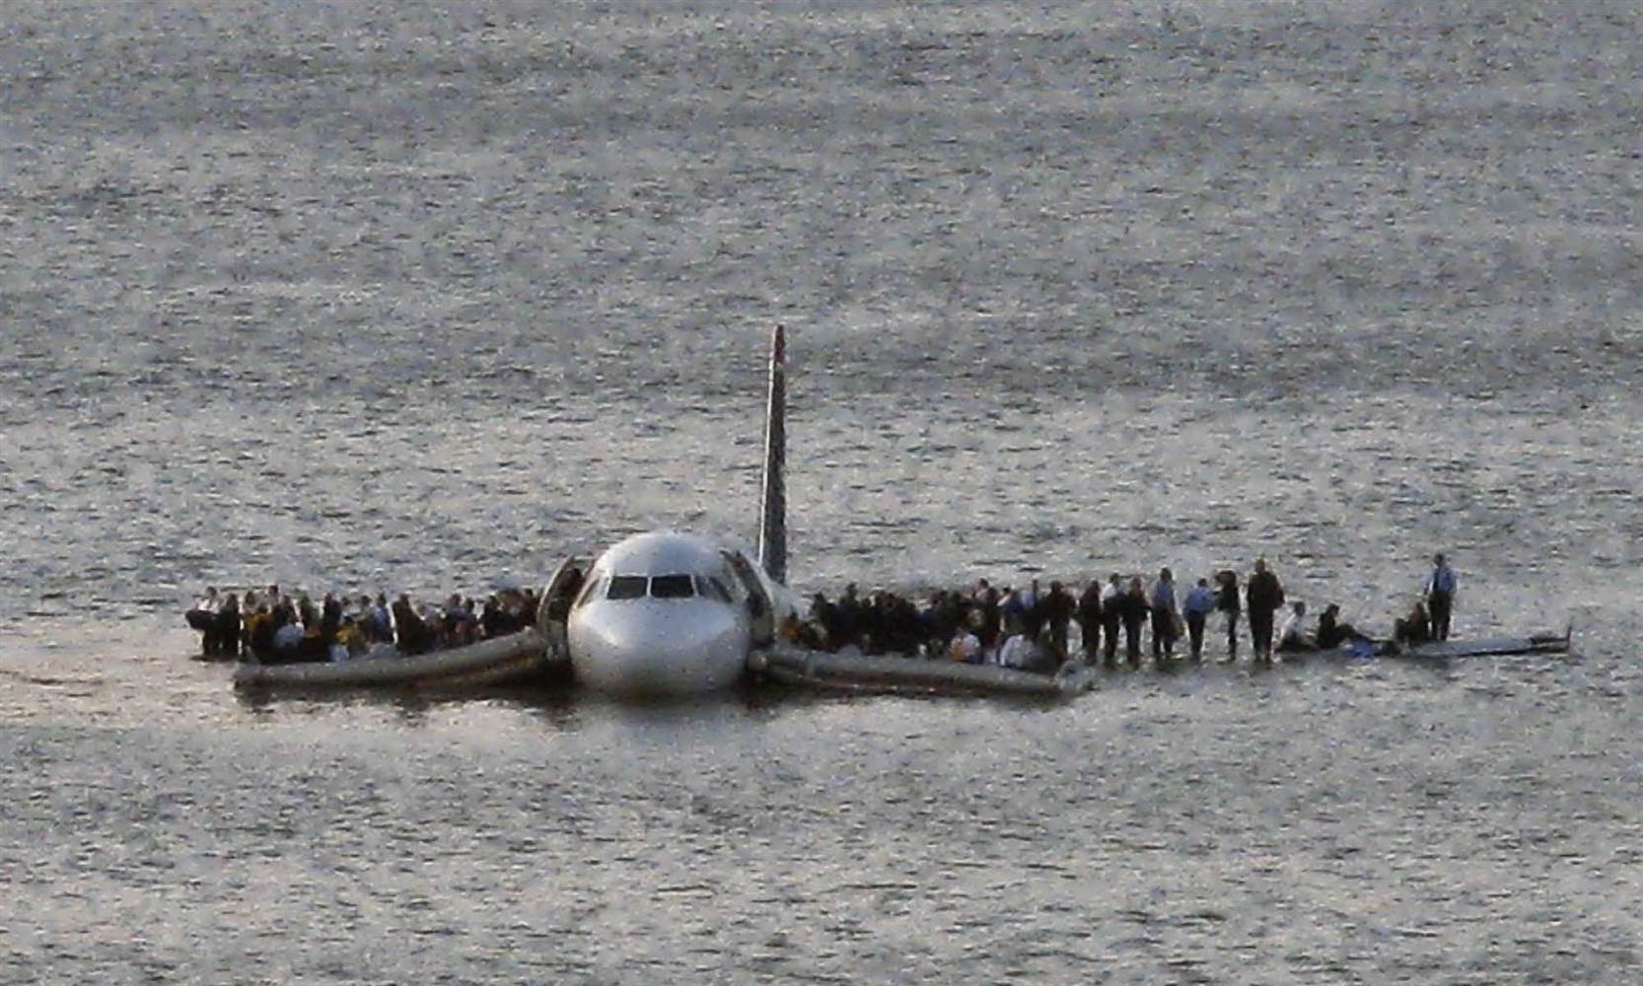
On The Hudson
Miracle
Airline passengers wait to be rescued on the wings of a U.S. Airways Airbus 320 jetliner that safely ditched in the frigid waters of the Hudson River in New York on Jan. 15, 2009. Steven Day / AP file

Slide 4
Why tell this story?
I tell you this story because this world is like Flight 1549. It is heading for destruction! Notice what The Bible says in 2 Peter 3:10, “But the day of the Lord will come as a thief in the night, in which the heavens will pass away with a great noise, and the elements will melt with fervent heat; both the earth and the works that are in it will be burned up.”

Slide 5
God is calling you
But God is calling a generation of young people for “such a time as this.”
Pathfinders who will STAND OUT and SPEAK UP like queen Esther so others might be saved.

Slide 6
Stand out!
When we think of Queen Esther we often think of a beautiful woman, and she was—in fact, she might have been the most beautiful woman in the entire Bible since none are described quite like her (See Esther 2:7). And she was much more than a pretty face! Esther was a woman with a character that shone brightly for God!

Slide 7
Stand out for Jesus
Ever notice how jewelers sell diamonds?
They place the diamond on black velvet so the diamond really shines!
They know that the darker the background the greater the contrast.
And did you know that the darker this world gets, the more we as Christians have an opportunity to stand out for Jesus?

Slide 8
Work cannot justify us
We can never be justified by our works in the sight of God, but we are always justified by our works in the sight of other human beings. This is why Jesus said, “In the same way, let your light shine before others, that they may see your good deeds and glorify your Father in heaven” (Matthew 5:16).

Slide 9

Global youth day
Global Youth and Young Adult Day! It’s a day where young people of all ages stand out and let their light shine for Jesus.

Slide 10
remember
We do not have to stand out in our own strength. Ephesians 2:10 says we are “God’s workmanship.”

Slide 11
Speak up!
God has not only called Pathfinders to STAND OUT
but to SPEAK UP as well.

Slide 12
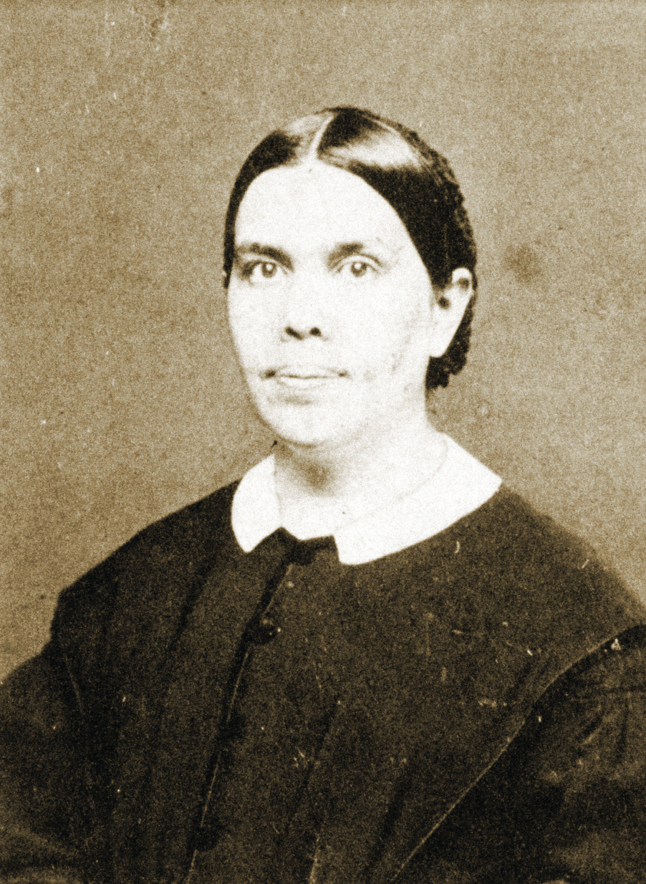
Set as watchmen
& lightbearers
Ellen White put it like this: “In a special sense Seventh-day Adventists have been set in the world as watchmen and light bearers. To them has been entrusted the last warning for a perishing world. On them is shining wonderful light from the Word of God. They have been given a work of most solemn import—the proclamation of the first, second and third angels message. There is no other work of so great importance. They are to allow nothing else to absorbed their attention” (Testimonies for the Church vol. 9. p. 19).

Slide 13
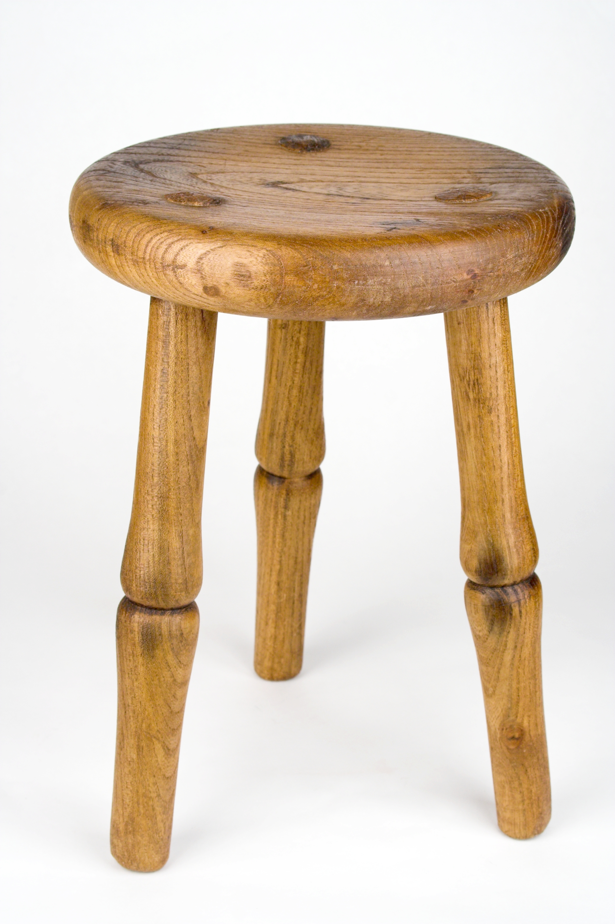
How do you tame a lion?
They say that a lion tamer uses a stool with three legs. The tamer holds it out between his or her body and the lion. The lion is unable to focus on attacking the tamer because it is distracted by the stool’s legs.

Slide 14
How do you tame the church?
How do you tame the Seventh-day Adventist Church? The same way! You get it distracted from its purpose of teaching, preaching and living out the “everlasting gospel” of the Three Angels’ Message.

Slide 15
The Good news
People need to hear the good news that Jesus is here and when we put our faith/trust in Jesus, He covers us in His righteousness.

Slide 16
security
You may not know a lot of things but if you know what the gospel is, you will have incredible confidence knowing your home is secure in heaven!

Slide 17

A greater responsibility
Seventh-day Adventists are not better than other Christians but we have been given a greater responsibility. Yes, God has called us to STAND OUT and SPEAK UP in these last days.

