Slide 1

evangelism
Mission Possible in 2012!

Slide 2
EVERY CHRISTIAN’S MISSION
Ye are a chosen generation, a royal priesthood, a holy nation, a peculiar people;

Slide 3
EVERY CHRISTIAN’S MISSION
…that ye should shew forth the praises of him who hath called you out of darkness into His marvelous light.
1 Peter 2:9

Slide 4
EVERY CHRISTIAN’S MISSION
I will pour out my Spirit upon all flesh; and your sons and your daughters shall prophesy, Joel 2: 28, 29

Slide 5
EVERY CHRISTIAN’S MISSION
…your young men shall see visions: and also upon the servants and upon handmaids in those days will I pour my spirit.
Joel 2: 28, 29

Slide 6
EVERY CHRISTIAN’S MISSION
your old men shall dream dreams, your young men shall see visions
Joel 2: 28, 29

Slide 7
EVERY CHRISTIAN’S MISSION
Go ye therefore, and teach all nations, baptizing them in the name of the Father,

Slide 8
EVERY CHRISTIAN’S MISSION
… and of the Son, and of the Holy Ghost: teaching them to observe all things whatsoever I have commanded you:

Slide 9
EVERY CHRISTIAN’S MISSION
…and of the Son, and of the Holy Ghost: teaching them to observe all things whatsoever I have commanded you:

Slide 10
EVERY CHRISTIAN’S MISSION
… and lo, I am with you always even unto the end of the world.
Matthew 28: 19, 20

Slide 11
GOD’S VISION
God wants a church with members who are ready to tell how God used them to testify for Him.

Slide 12
EVERY TRUE CHRISTIAN WOMAN IS AN EVANGELIST

Slide 13
No woman is excused: Some can do more than others; but all can do something. Women should not feel that they are excused because of their domestic cares.

Slide 14
They should become intelligent as to how they can work most successfully and methodically in bringing souls to Christ. Daughters of God, pages 15,16

Slide 15
GOD IS INVITING WOMEN TO DO EVANGELISM

Slide 16
The Lord of the vineyard is saying to many women who are now doing nothing, Why stand ye here all the day idle?

Slide 17
They may be instruments of righteousness, rendering holy service…

Slide 18
The refining, softening influence of Christian women is needed in the great work of preaching the truth now.

Slide 19
If there were twenty women where now there is one who would make the saving of souls their cherished work, …

Slide 20
…. we should see many more converted to the truth.”
Daughters of God, page 18

Slide 21
GOD CALLS
UPON WOMEN TO DO EVANGELISM

Slide 22
“Women of firm principles and decided character are needed; women who believe that we are indeed living in the last days,...

Slide 23
and that we have the last solemn message of warning to be given to the world. …

Slide 24
They should feel
that they are engaged
in an important work in spreading the rays of light,...

Slide 25
...which Heaven has shed
upon them...
Such persons can in many ways
do a precious work for God.

Slide 26
He calls upon them to go into the harvest field, and help gather in the sheaves.
Daughters of God, page 17

Slide 27
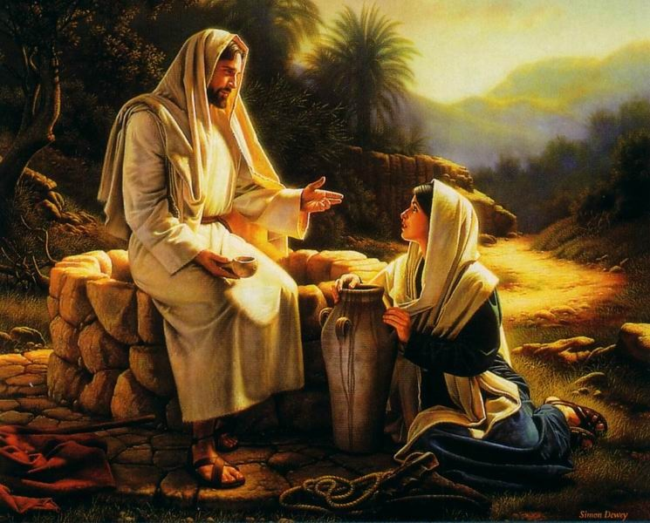
WOMEN ARE NEEDED IN
EVANGELISM

Slide 28
The Lord has a work for women, as well as for men....

Slide 29
The Savior will reflect upon these self-sacrificing women the light of His countenance,

Slide 30
and will give them a power
that exceeds that of men.

Slide 31
They can do in families a work that men cannot do, a work that reaches the inner life.

Slide 32
They can come close to the hearts of those whom men cannot reach.
THEIR LABOR IS NEEDED.
Review and Herald, August 26, 1902

Slide 33
EVANGELIZE?
WHERE?

Slide 34
Home
Neighborhood
Work place
Church

Slide 35
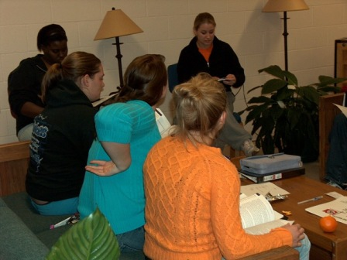
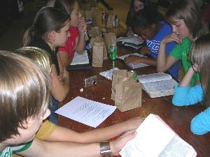
EVANGELIZE? HOW?
Small Groups

Slide 36
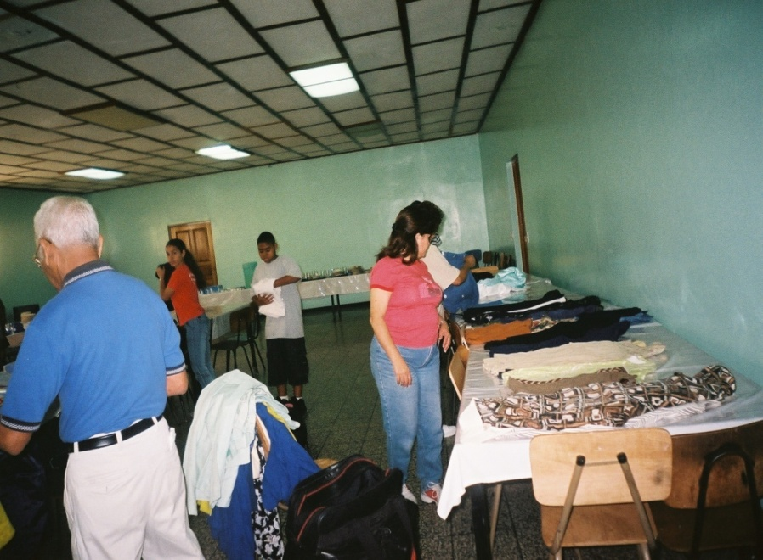
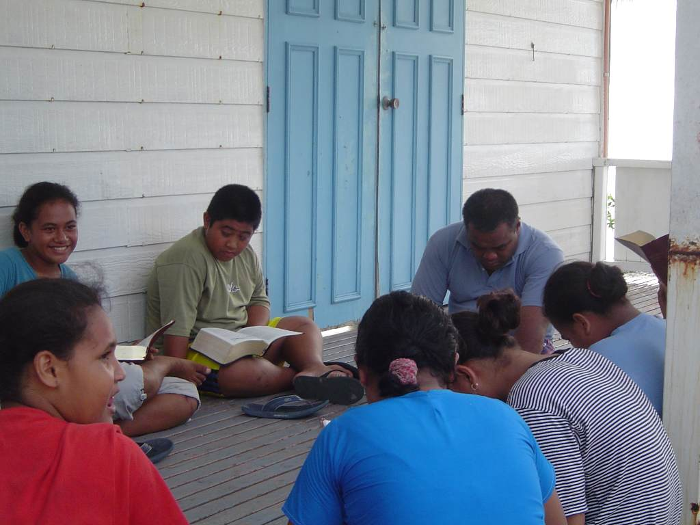
BIBLE STUDIES
FRIENDSHIP EVANGELISM
HEART CALL

Slide 37
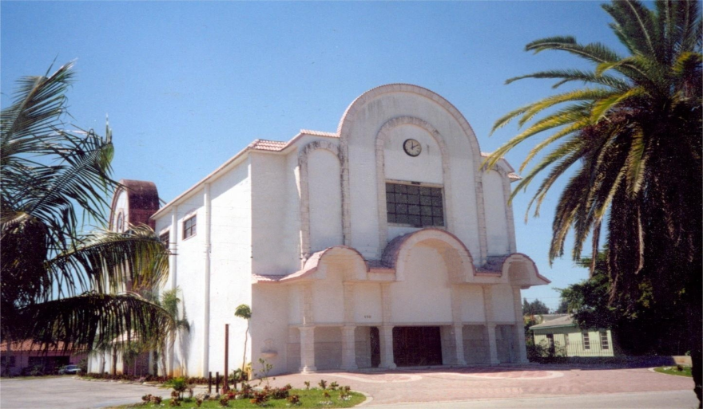
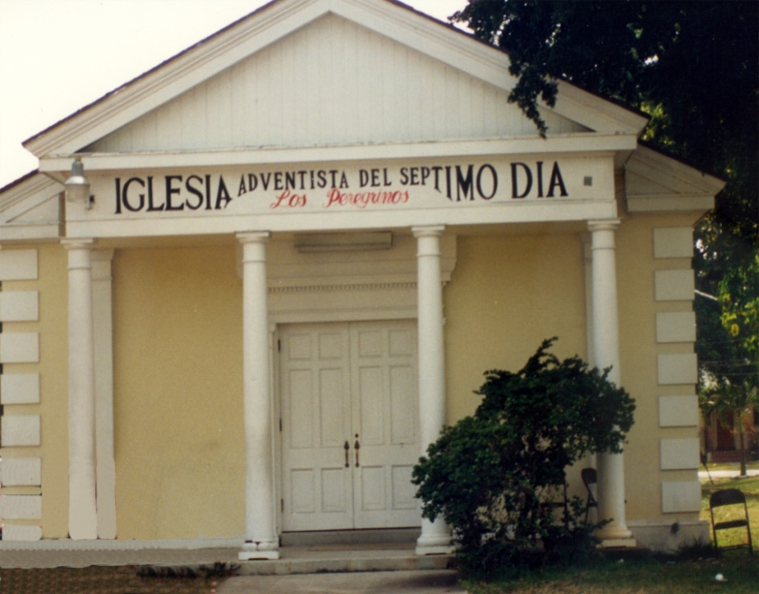
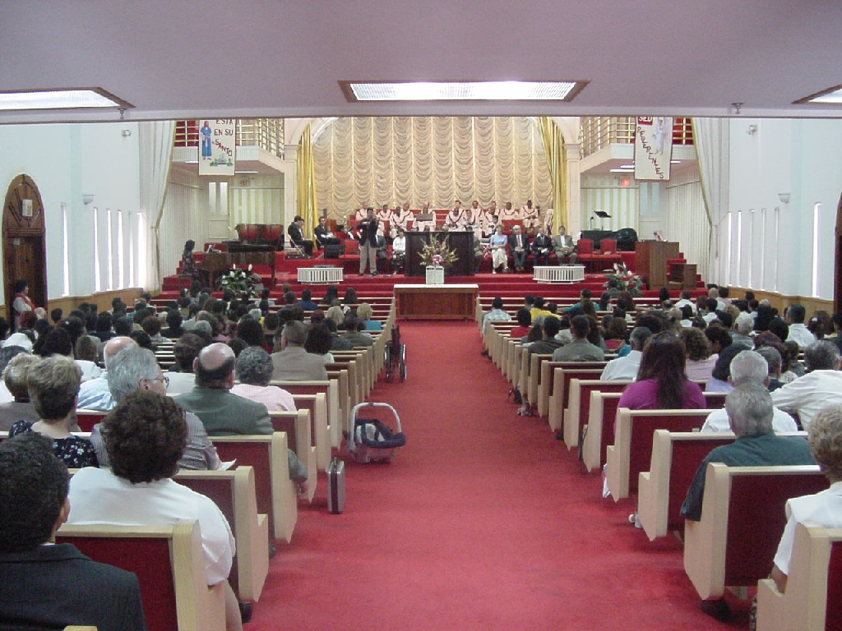
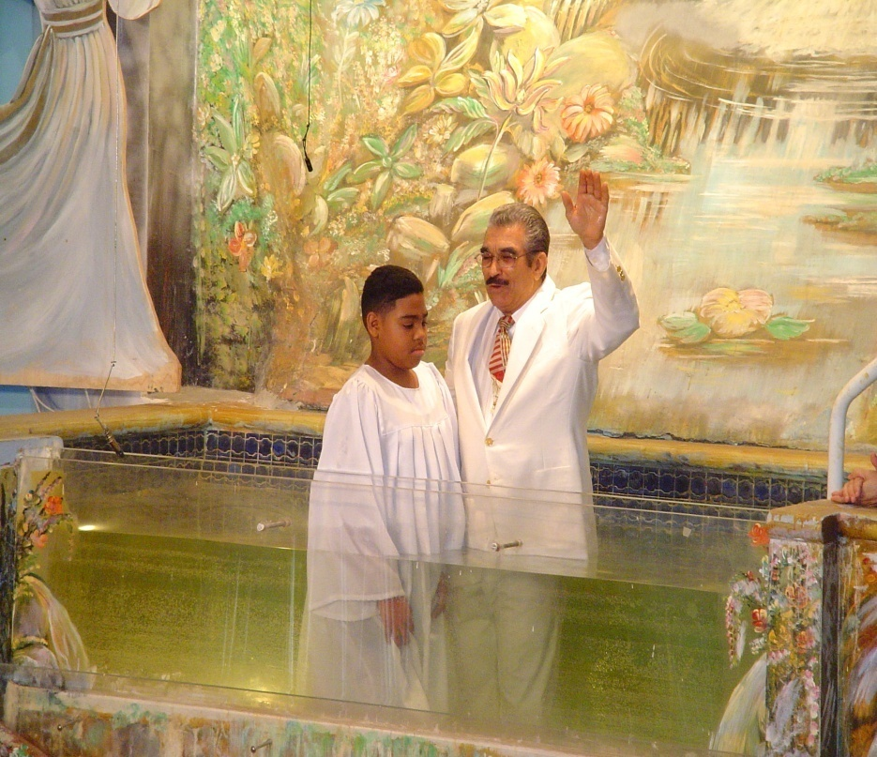
PUBLIC EVANGELISM”

Slide 38
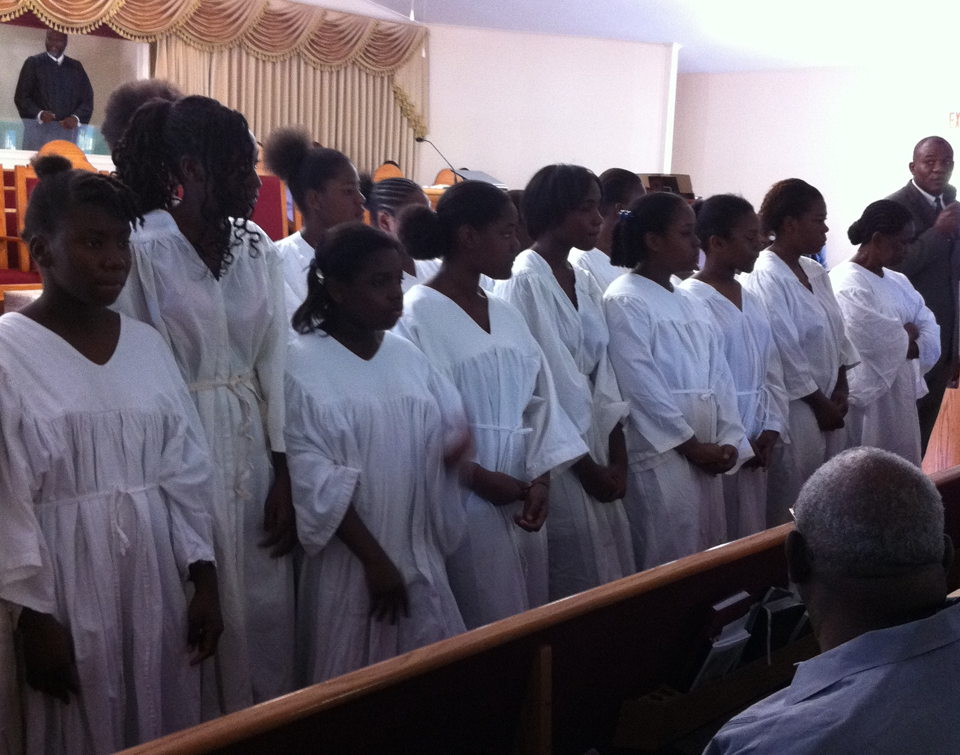
AT CHURCH

Slide 39
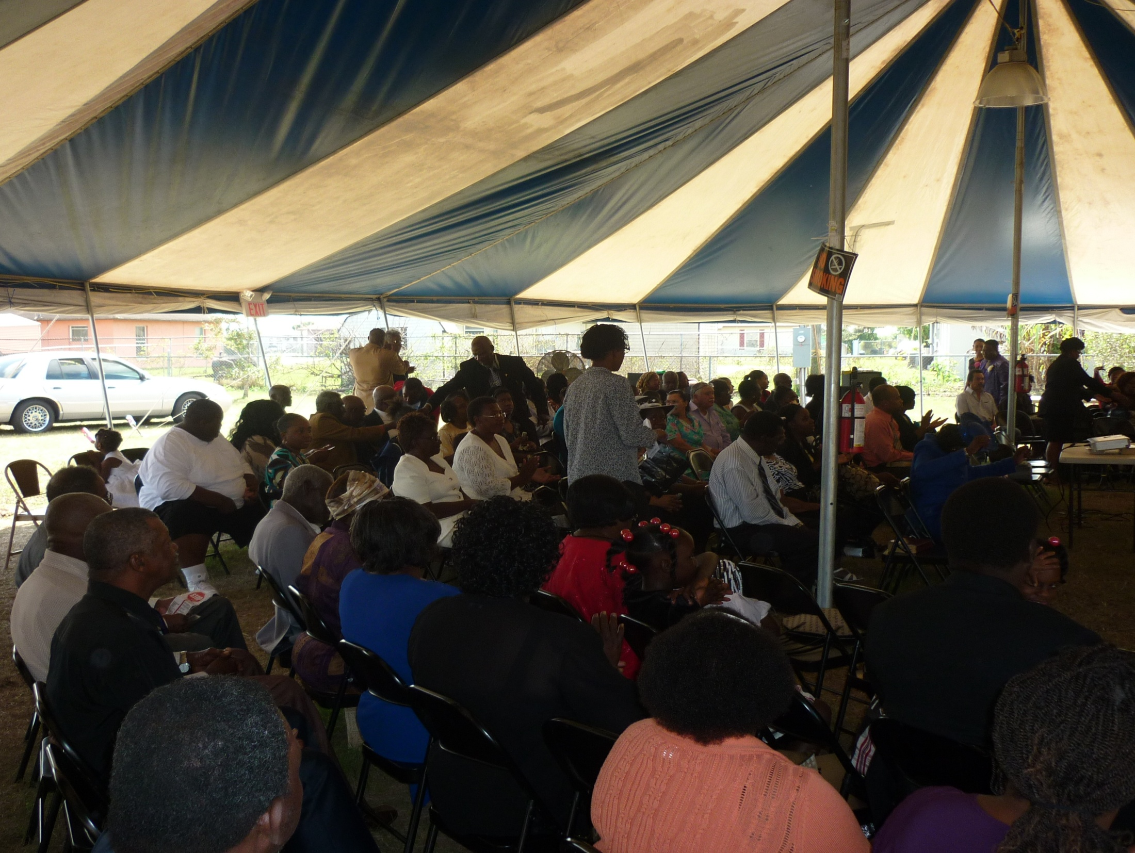
UNDER A TENT

Slide 40
ORGANIZATION
Personal prayer
Motivate your committee
Organize prayers
Sharing with your pastor
Get Church board support

Slide 41
Choose a date
Motivate the ladies of church
Plan:
  Material – Share Him
  New Beginning
  Bible Studies

Slide 42
ORGANIZATION
Choose Speakers
    Assign responsibilities
    Prepare Budget
    Date for rehearsing
    Plan after campaign

Slide 43
Prepare your campaign participants’ schedule and post it
Organize groups of prayer and/or church praying

Slide 44
PROGRAM
Simple/ Lively
Prayer/ Hospitality/Gifts/Music
Transportation/Bible Workers
Presentation of the Word

Slide 45
TESTIMONIES

Slide 46
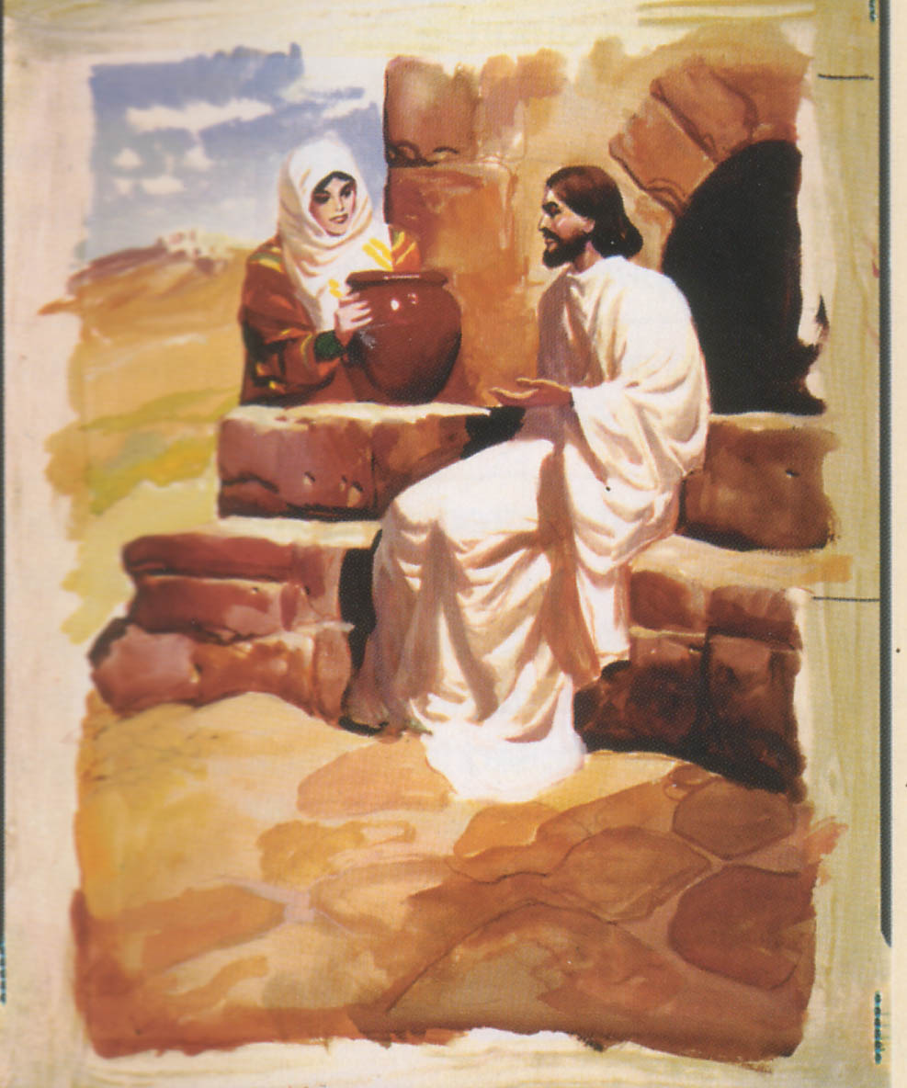
The Samaritan Woman
John 4:1-43

Slide 47
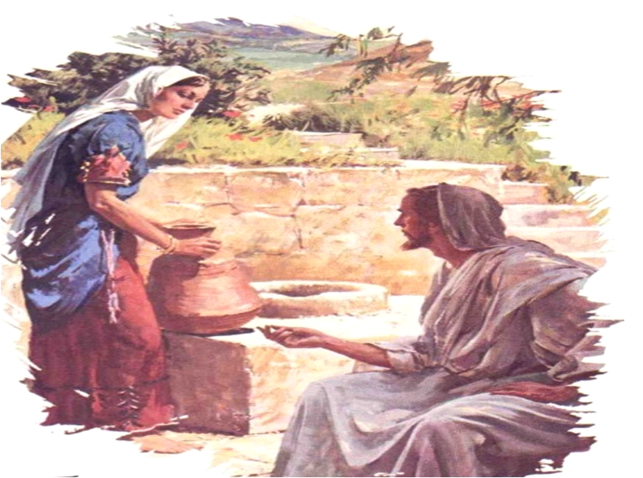
CONCLUSION

Slide 48
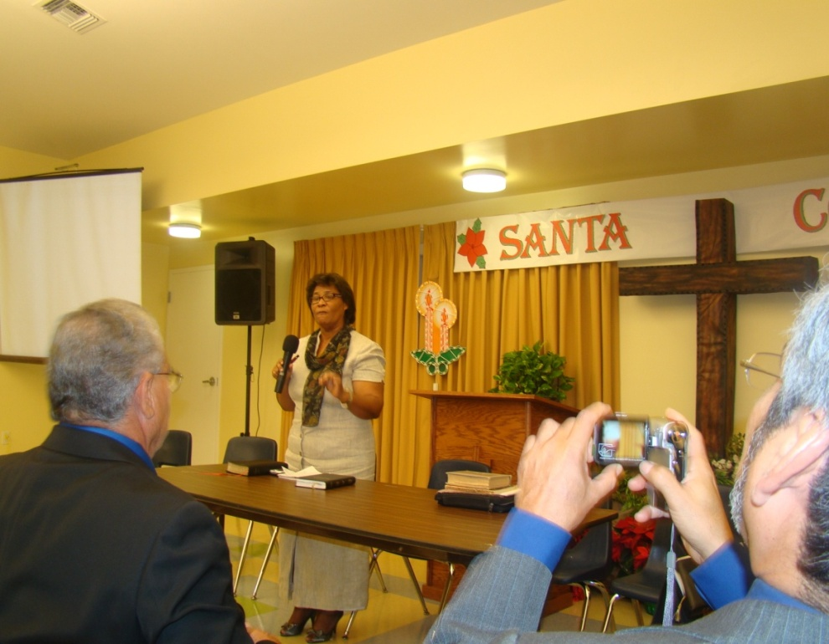
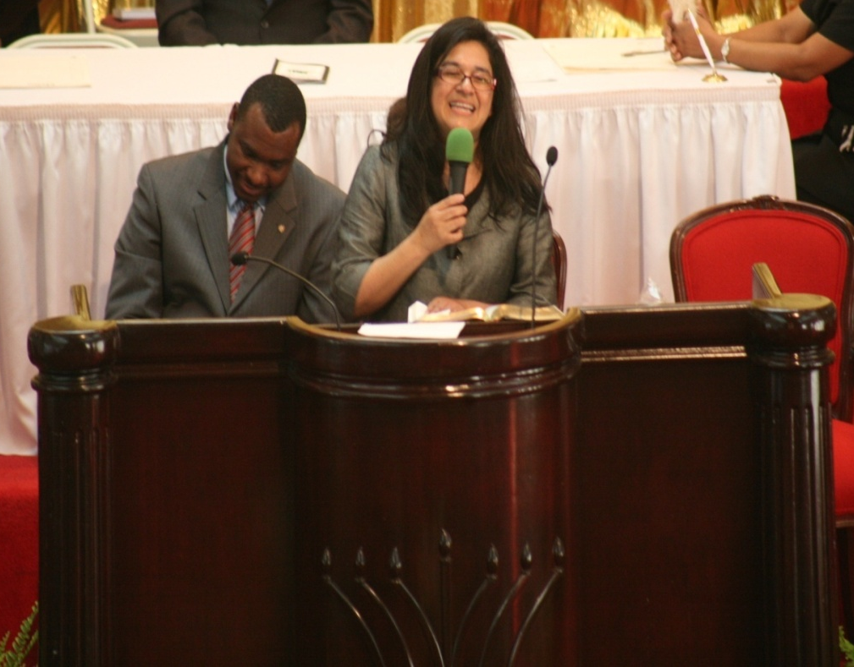
We are called to proclaim the special truths for this time.

Slide 49

What is your chief desire in life?
Are you regularly sharing your faith with others?

Slide 50
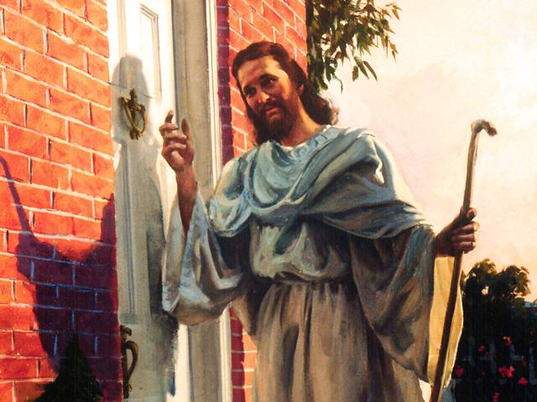
Jesús quiere derribar las barreras de su vida

