Slide 1

Social Ministry Tactics to Help Your Ministry
Robert Henley, M.A., MCSE, MCT
Communication, Technology and Interactive Ministries

Slide 2
What is Social Media and why should we get involved with it?

Slide 3
What is Social Media

Slide 4
Social Media Facts
If Facebook were a country, it would be the third largest in the world, behind China and India.
One-third of women 18-34 check Facebook first thing when they wake up everyday.
Youtube serves over a billion videos a day. That’s 11,574 views per second.
The fastest growing segment on Facebook is 55-64 year old females.

Slide 5
Social Media Facts
There are 80 million users on Twitter.
There are 200,000,0 blogs.
80% of companies use social media.
Today’s generation considers e-mail passé.
1 out of 8 couples met via social media networks.
96% of Millennials (1980 – 2000) have joined a social network.

Slide 6
Social Media Facts
50% of the mobile Internet traffic in the UK is for Facebook
New survey results also show that among adults 18 and older, Facebook has taken over as the social network of choice
73% of adult profile owners use Facebook, 48% have a profile on MySpace and 14% use LinkedIn

Slide 7
Social Media Facts
1.7 billion people are logging onto the web on an ongoing bases.
Internet World Stats, http://www.internetworldstats.com/stats.htm

Slide 8
Social Media
Social Networking
Blogging
Micro blogging
Video
Photos Sharing
Podcasting

Slide 9
Popular Social Media Sites
Facebook
Twitter
FLICKR
LiveStream
YouTube

Slide 10

Kristi’s Story
Kristi’s Story
Notes:
Everystudent.com “I didn’t think that organized religion was an important thing. It wasn’t necessary and I had no interest whatsoever.” like so many others, Kristi had been disappointed by overzealous believer in the past. “ I had some bad experience with people saying, Oh, you’re going to hell.” I would have been very turned off if someone would have come up and tried to evangelize me on the street.”

Slide 11
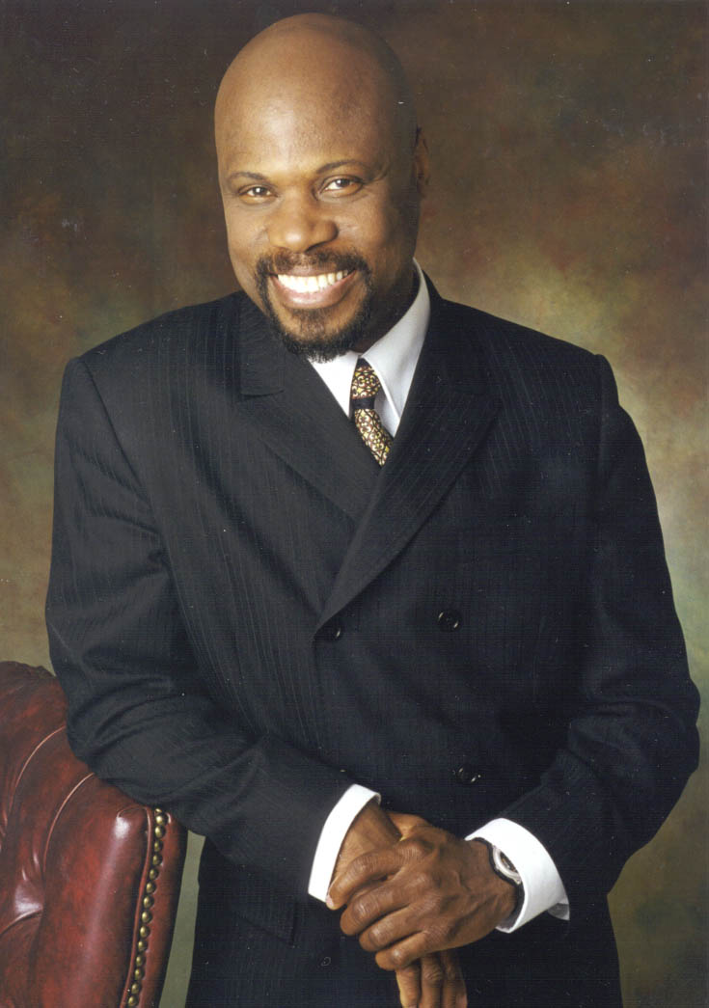
Wintley Phipps on YouTube

Slide 12
Our Mission

Slide 13
Again, the kingdom of heaven is like a net that was cast into the sea and gathered some of every kind. Matt. 13:47

Slide 14
Let the workers for God manifest tact and talent, and originate devices by which to communicate light to those who are near and to those who are afar off.
The Voice in Speech and Song 282

Slide 15
“You and I are the first generation to hold the technology to reach every person with the gospel and to accomplish the task of the Great Commission. “ Walt Wilson, founder and chairperson of Global Media Outreach

Slide 16
Current Internet Evangelism Strategies

Slide 17
99 to 1 Problem
99 percent of Christian websites are created for other Christians.
1percent of Christian websites are designed to evangelize the lost
Tony Wittaker, Web Evangelism Guide, 2007 http://www.webevangelism.com

Slide 18

Differentiate or Die

Slide 19
"Thousands of churches are not walking through the unprecedented number of open doors social networking has provided them...To not be proactive in wireless communications today is to not be communicating”
Bob Hutchins, Owner of BuzzPlant

Slide 20
There is among us to much clinging to old customs, and because of this we are far behind where we should be in the development of the third angel's message. Counsels to Parent, Teachers and Students 533

Slide 21
New methods must be introduced. God’s people must awake necessities of the time in which they are living. God has men whom he will call into his service,- men who will not carry forward the work in the lifeless way in which it has been carried forward in the past….
Evangelism 70.1

Slide 22
Not with tame, lifeless utterance is the message to be given, but with clear, decided, stirring utterances.—Testimonies for the Church 8:16. Christian Service 229

Slide 23
Let us not forget that different methods are to be employed to save different ones.—The Review and Herald, April 14, 1903. – Evangelism 106

Slide 24
Do Not Block the Wheels —There are some minds which do not grow with the work but allow the work to grow far beyond them.... Those who do not discern and adapt themselves to the increasing demands of the work, should not stand blocking the wheels, and thus hindering the advancement of others.— Letter 45, 1889. – Evangelism 104

Slide 25
There must be no fixed rules; our work is a progressive work, and there must be room left for methods to be improved upon. But under the guidance of the Holy Spirit, unity must and will be preserved.— The Review and Herald, July 23, 1895. – Evangelism 105

Slide 26
Different Methods From the Past—Means will be devised to reach hearts. Some of the methods used in this work will be different from the methods used in the work in the past; but let no one, because of this, block the way by criticism.— The Review and Herald, September 30, 1902. – Evangelism 105

Slide 27
I had dreamed that a person brought to me a web of white cloth, and bade me cut it into garments for persons of all sizes, and all descriptions of character, and circumstances in life. Christian Service 63

Slide 28
Men are needed who pray to God for wisdom, and who, under the guidance of God, can put new life into the old methods of labor and can invent new plans and new methods of awakening the interest of church members and reaching the men and women of the world. —Manuscript 117, 1907. – Evangelism 105

Slide 29
From that time Jesus began to preach and to say. “Repent, for the Kingdom of heaven is at hand”. Matthew. 4:17

Slide 30
And the disciples came and said to Him, “Why do you speak to them in parables?” Matthew 13:10

Slide 31
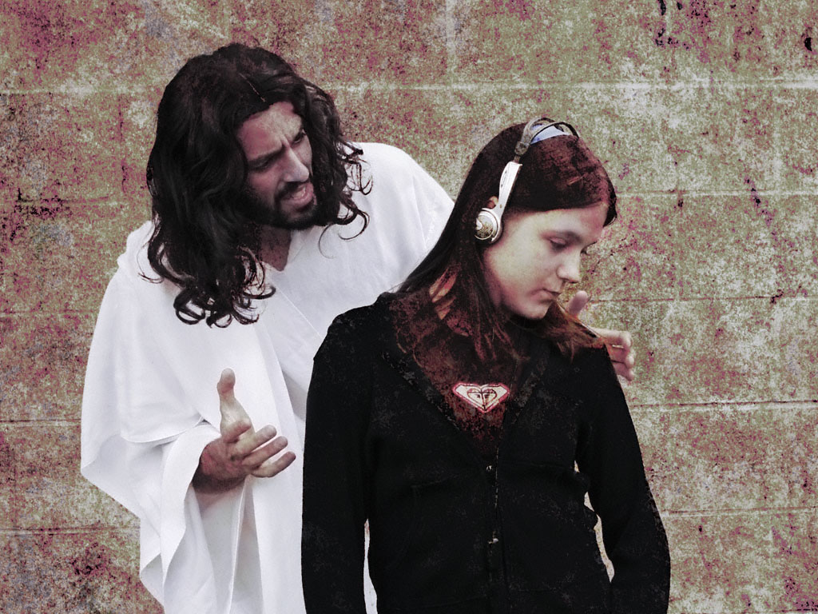

Slide 32
In the earlier part of His ministry, Christ had spoken to the people in words so plain that all His hearers might have grasped truths which would make them wise unto salvation. But in many hearts the truth had taken no root, and it had been quickly caught away.

Slide 33
Jesus desired to awaken inquiry. He sought to arouse the careless, and impress truth upon the heart. Parable teaching was popular, and commanded the respect and attention, not only of the Jews, but of the people of other nations.

Slide 34
No more effective method of instruction could He have employed. If His hearers had desired a knowledge of divine things, they might have understood His words; for He was always willing to explain them to the honest inquirer.

Slide 35
Again, Christ had truths to present which the people were unprepared to accept or even to understand. For this reason also He taught them in parables. By connecting His teaching with the scenes of life, experience, or nature, He secured their attention and impressed their hearts.

Slide 36
Jesus sought an avenue to every heart. By using a variety of illustrations, He not only presented truth in its different phases, but appealed to the different hearers.

Slide 37
Their interest was aroused by figures drawn from the surroundings of their daily life. None who listened to the Saviour could feel that they were neglected or forgotten.

Slide 38
The press is a powerful means to move the minds and hearts of the people. The men of this world seize the press, and make the most of every opportunity to get poisonous literature before the people.

Slide 39
If men, under the influence of the spirit of the world and of Satan, are earnest to circulate books, tracts, and papers of a corrupting nature, you should be more earnest to get reading matter of an elevating and saving character before the people. Publishing Ministry 44

Slide 40
Social Media is a powerful means to move the minds and hearts of the people. The men of this world seize technology, and make the most of every opportunity to get poisonous content before the people.

Slide 41
If men, under the influence of the spirit of the world and of Satan, are earnest to use blogs, wikis, tweets, FaceBook pages, and podcasts of a corrupting nature, you should be more earnest to get content of an elevating and saving character before the people. Publishing Ministry 44

Slide 42
And he saith unto them, Follow me, and I will make you fishers of men.
Matthew 4:19 (King James Version)

Slide 43
One of the most valuable skills for the fly fishers is to learn to “read” the water. . . . [Trout] like deep, clear, weedless pools, where they can easily see their prey, and often hang out in eddies, where food is plentiful.

Slide 44
It helps, too, to know that trout face upstream, with their noses into the current. If you know the direction a fish is facing, then you will know where to place the fly. Otherwise you can cast all day with perfectly good flies and catch nothing. All I Needed to Know about Ministry I Learned from Fly Fishing, pg. 11

Slide 45
How Churches Use Social Media
62% of churches have their sermons on a website or do a pod-cast
28% of the churches surveyed post a blog by their pastor
32% use social media to get feedback from the membership
25% always use social media in the promotion of special church events and activities.

Slide 46
Social media facilitate church leaders moving their people and ministries beyond Sabbath morning. You can reference weekday activities, for example, off-site ministries such as mission trips, and call attention to Web resources such as the Virtual Abbey, a blog service where, among other things, they “pray the Daily Office via Twitter.”

Slide 47
Social media like Facebook and Twitter are changing our world, including how faith communities function. Opportunities abound to use them as a ministry communications tool.
Tom Ehrich, Church Wellness

Slide 48
Internet Trends

Slide 49
Adult Usage
47% go online with a laptop using a Wi-Fi connection or mobile broadband card
40% of adults use the internet, email or instant messaging on a mobile phone

Slide 50
Cell Phone Usage
Take pictures—76%
Send or receive text messages—72%
Access the internet—38%
Play games—34%
Send or receive email—34%
Record a video—34%
Play music—33%
Send or receive instant messages—30%

Slide 51
Cell Phone Usage
Cell phone ownership is higher among African-Americans and Latinos than among whites (87% vs. 80%) and minority cell phone owners take advantage of a much greater range of their phones’ features compared with white mobile phone users.

Slide 52
Mobile Web
64% of African-Americans access the internet from a laptop or mobile phone, a seven-point increase from the 57% who did so at a similar point in 2009.

Slide 53
Text Messaging
Young adults (those ages 18-29) are also avid users of mobile data applications, but older adults are gaining fast. Compared with 2009, cell phone owners ages 30-49 are significantly more likely to use their mobile device to send text messages, access the internet, take pictures, record videos, use email or instant messaging, and play music.

Slide 54
Teens are sending enormous quantities of text messages a day. Half of teens send 50 or more text messages a day, or 1,500 texts a month, and one in three send more than 100 texts a day, or more than 3,000 texts a month

Slide 55
Older teen girls ages 14-17 lead the charge on text messaging, averaging 100 messages a day for the entire cohort. The youngest teen boys are the most resistant to texting – averaging 20 messages per day.

Slide 56

Ways That America Experiences Ministry Today

Slide 57
Barna Research Group predicts that by the end of the decade, upwards of 100 million Americans will rely on the Internet to deliver some aspect of their religious experience.
The CyberChurch, Barna Research Group

Slide 58
A greater number of adults experience their Christian faith through Christian media.
6 out of 10 American adults (63%) attended a church service during the past month.
2 out of 3 adults (67%) used at least one of four forms of religious media - radio, television, Internet or books.
The CyberChurch, Barna Research Group

Slide 59
38% have sent e-mails with spiritual content.
32% have gone online to read news accounts of religious events.
21% have sought information about how to celebrate religious holidays.
17% have looked for information about where they could attend religious services.

Slide 60
17% have looked for information about where they could attend religious services.
7% have made or responded to online prayer requests.
7% have made donations to religious organizations.
64% of Internet users in the United States perform religious and spiritual activities online.

Slide 61
50 million will seek to have their religious experience solely through the Internet rather than at a brick-and-mortar church.
43% of churches say social media is one of the most effective ways to communicate and engage with people.
77% of people say the church website was an important part of why they chose to go to church
If people can’t connect to your website the may not go to your church

Slide 62

Some Examples

Slide 63
TD Jakes
Church Website
Branded Website
Twitter
FackeBook http://www.facebook.com/tdjministries

Slide 64
Joel Osteen
Branded
Church http://www.lakewood.cc/
Flickr
Facebook
Twitter
YouTube

Slide 65
Social Media Tactics

Slide 66
YouTube
Post Compelling personal testimonies
Posting videos of creative ministry and youth programs
Post video promos of upcoming events
Post video excerpts of sermons and conferences

Slide 67
Facebook
Use Facebook’s church app to broadcast live, streaming online worship services
Use Facebook’s Fan Page as your ministry’s website
Use Facebook to post and receive prayer requests.
Stay connected with your church’s youth group.

Slide 68
Facebook
Pastor can post updates about their day.
Post questions on Facebook to stimulate active dialog on issues.
Facebook posts can expose the unchurched to Christian fellowship
Conduct surveys
Announce events and news

Slide 69
Twitter
Use Twitter to connect with staff members
Use Twitter to point to your ministry’s blog posts, articles, website, or other resources.
Use Twitter to solicit help for causes
Use Twitter to announce news and events
Use Twitter to solicit prayer requests
Create a Twitter account for each ministry

Slide 70
LinkedIn

Slide 71
Tools
Joomla
Drupal
Word Press
WireCast
Google Analytics
LiveStream.com
Vimeo

Slide 72
Develop a Plan
Establish a Vision
Identify your audience
Integrate
Culture Change
Capacity
Tactics and Tools
Measure your effectiveness
Experiment

Slide 73
Ten Steps for Developing a Social Media Marketing Plan
1. Think about the other promotional tactics you are already using and how social media fits in with them.
2. Decide how high a priority should be placed on social marketing, compared with your other marketing activities. How many hours a week can you devote to it?
3. Determine what target audiences you want to reach through social marketing.

Slide 74
4. Set objectives, describing what you hope to gain by marketing through social media.
Based on your objectives, set specific, achievable, and measurable goals for your social marketing activities.
Notes:
Add five new incoming links to your website this month
• Double the traffic to your website within two months
• Increase your opt-in mailing list by twenty five percent within three months

Slide 75
6. Develop your branding
7. Determine which social marketing tactics are the best fit for your book, your audiences, your objectives, and your available time.
Decide how you will measure the effectiveness of your social marketing efforts. What metrics will you track and what tools will you use to measure them.
Notes:
Friends or followers on social networks
• Sales of books and other products and services
• Business contacts (peers, influencers, media, potential partners)
• Weekly unique visitors and return visitors to your website and blog
• Subscribers to your mailing list and blog
• Visitors to your website and blog
• Inbound links to you website and blog

Slide 76
9. Implement your chosen social marketing tactics, one at a time.
10. Evaluate your progress periodically. Can you tell which activities are generating the best results? Are some activities taking up too much of your time? Make adjustments to your strategy as necessary.
Excerpted from The Savvy Book Marketer's Guide to Successful Social Marketing by Dana Lynn Smith.

Slide 77
5 Objectives of Using Social Media
1. Listening. Social Media is a conversation. As people participate you will have the opportunity to learn and benefit from those takeaways.
2. Talking. Use Social Media as an opportunity to double down on your communication regarding your church's vision or communicate opportunities to serve. There is so much noise in our culture, so it doesn't hurt to have another conduit to communicate.

Slide 78
Focus on mobile digital devices and cell phones
Become an expert on search optimization
Become familiar with convergence
Stay up to date
Learn how to tell the story of Christ in 60 seconds.

Slide 79
What are your resources (money, talent, time, volunteers)
Who is your target audience? What are their cultural, religious, political, socioeconomic, age, and gender distinctives?
What tools/methods will work to reach your target audience online?
What platform or platforms will I use?

Slide 80
How often will you update your site?
Will you respond to email personally?
How will you monitor your site?

Slide 81
3. Energizing. This is similar to talking, but the objective here is to mobilize and empower the champions and connectors in the church to be the fuel of the ministry.
4. Supporting. Through Social Media, your church can provide others the tools and resources they need for spiritual growth.

Slide 82
5. Connecting. The objective of Social Media is to connect people together, to have them talk to one another. So your role is to act as a facilitator to help those in your church engage and come together toward a common mission and objectives.

Slide 83
Activity

Slide 84
Resources
Lynda.com - Training
Net Casters: Using the Internet to make fishers of men, Craig Von Buseck

Slide 85
Resources
http://blog.ourchurch.com/
http://www.internetevangelismday.com/
http://www.webevangelism.com/
http://www.fishthe.net/
http://www.churchmarketingsucks.com/
http://ministrymarketingsolutions.blogspot.com/

Slide 86
http://www.mailchimp.com/churches/

