Slide 1



Long Term Missions
Presented
by
Ernest Hernandez

Slide 2
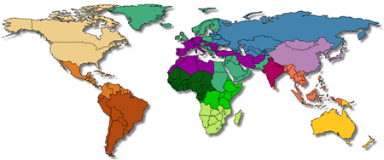
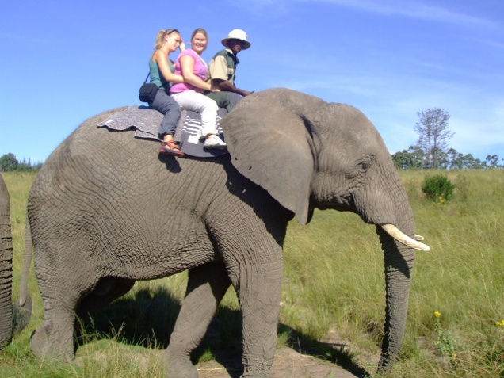

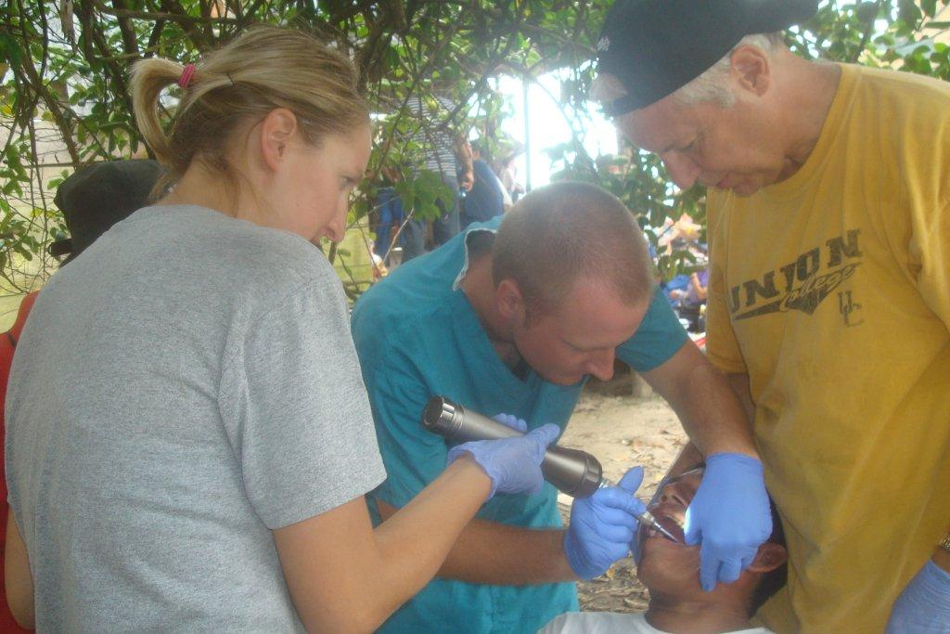
Recruiting Volunteers
Notes:
Recruited from different needs, 2 months, 1 year, 2 years, from youth trips..graduating to volunteers that support missionaries (1000 – 50% students, 50 – working populations) found through website, mission posts, newsletters, social media, school campuses, Service Request Posts.
Different needs: adventure, experience God, application of their career emphasis – All want to serve God

Slide 3
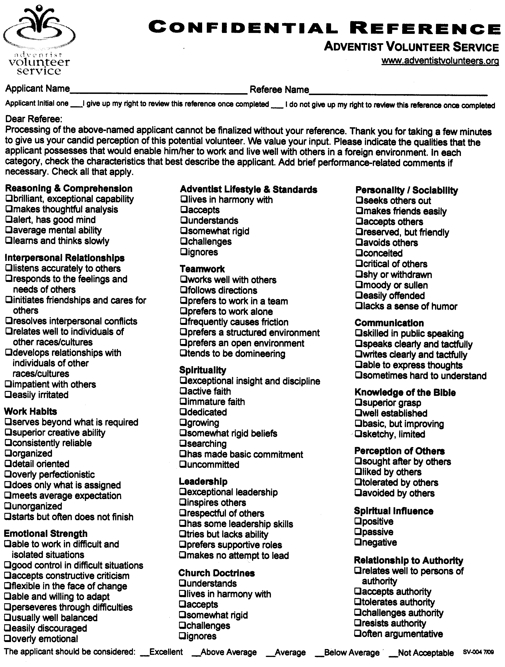
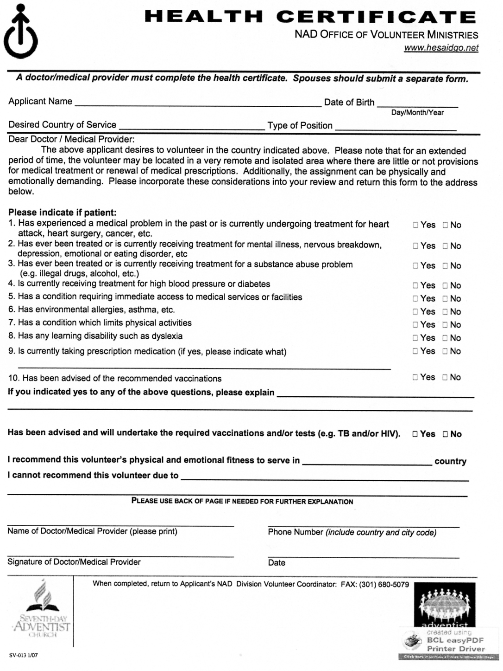
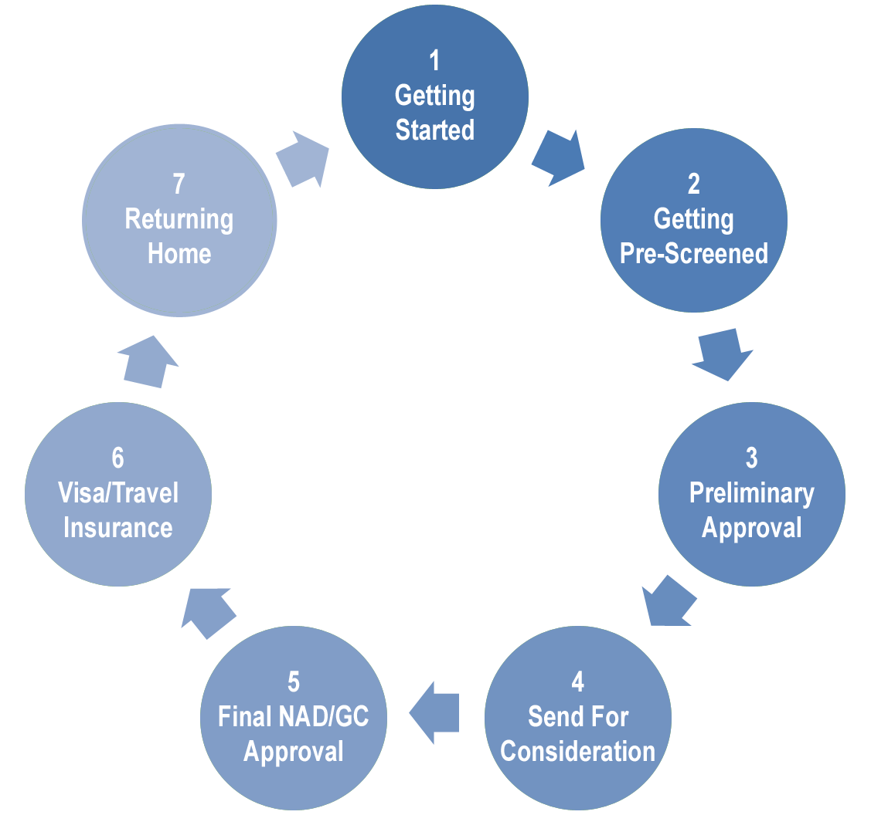
Processing
Overview
Notes:
References, (spiritual, educational, experience) Health Cert., Liability, Beneficiary. Step 6: Accident and Sickness Ins. – main features: evacuation, repatriation, life ins., baggage claim, legal assistance,

Slide 4


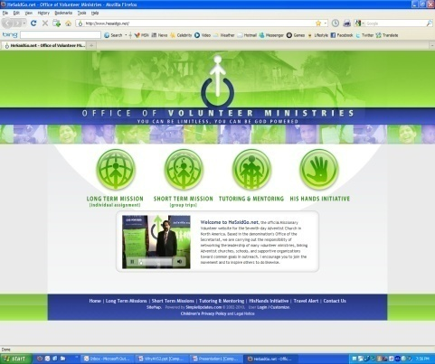

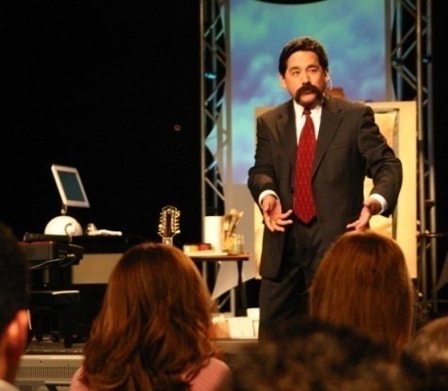
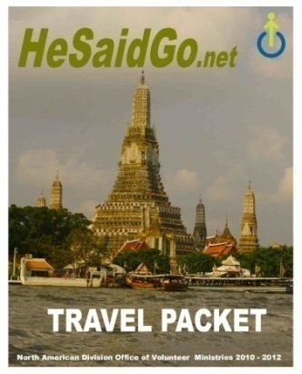
Management
Hiring Safeguards
Screening
Training
Division-wide
Communication
Recruitment/Awareness
Insurance/Immigration
4
Notes:
Follow sound HR practices, comprehensive vetting (incarnational ministry), discipleship,

Slide 5
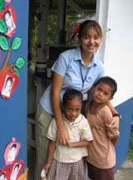
Engaging
the
World
of
Volunteers
Notes:
Notice: I didn’t say “engaging the world through volunteers. That is the result of what we do. Rather, our mission is to engage the world “of” volunteers”…to point them in the right direction, to equip them for service….to send forth laborers…for the harvest is ready. Therre are multitudes of Christians willing to be used for the service of God. They are asking “Where can I serve. I am ready.” As the world economies continue to struggle, the volunteer workforce continues to grow. Our goal for this year is to increase these 1000 long term volunteers into 2000. How? Through social media services, through automation that can reach more of the U.S. population through initial pre-screening (using information secured through statistical analysis drawn from historical data). By connecting with our return volunteers (who then become employees of the Church – Pastors, Chaplains, teachers, medical personnel, campus ministries directors). By engaging a volunteer workforce through initiatives that encourage the different levels of commitment that we identify as the three stages of “See the World, Experience God Fulfill Your Mission”

Slide 6
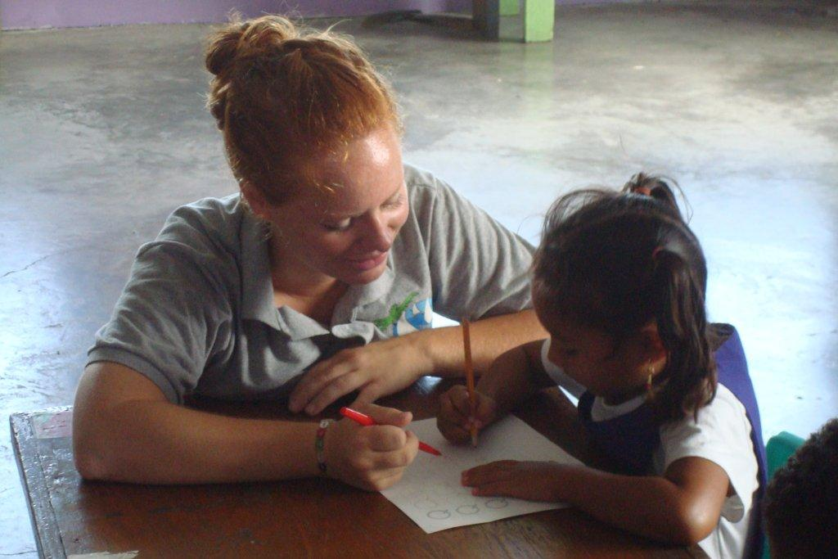
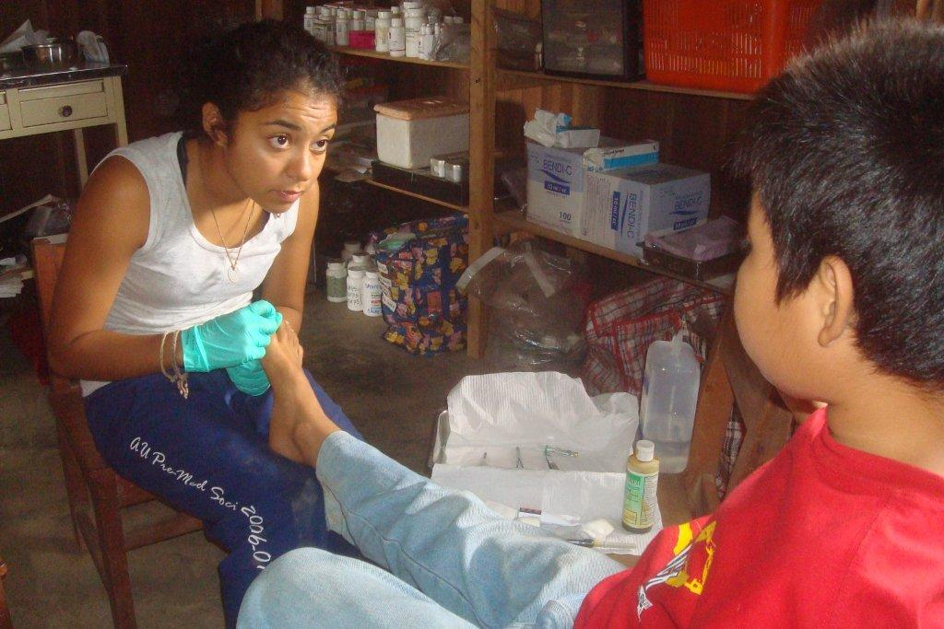

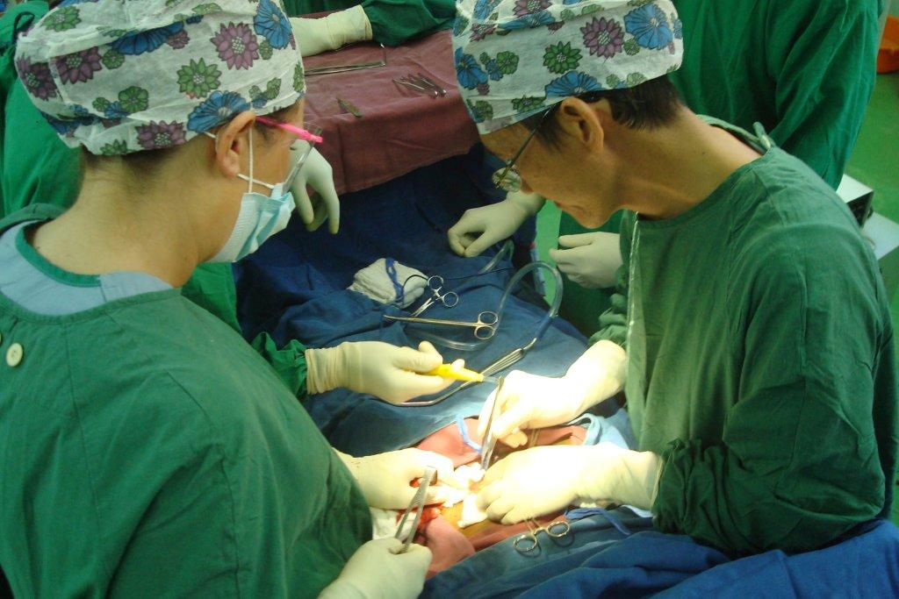

Long Term Missions
Notes:
HeSaidgo - If there is one sign that we can say is the single identifying event that will usher the return of Jesus Christ, it is the proclamation of the Gospel to the ends of the earth.
The clergy cannot do it alone, the career missionary cannot do it alone…but an army of lay christian under the power of the almighty…a volunteer army, I am convinced that this is where God will manifest his greatest work, as folks like you and me heed the call “He Said Go”.

