Slide 1


Slide 2

Question:
Why are so many young people drowning spiritually?

Slide 3



Slide 4
Read John 10:10
How should youth and young adults in the church live out their lives?

Slide 5

Announcing
Mission Lifeguard
Chapter 1

Slide 6

Announcing
Mission Lifeguard
Describe the Culture
at Your Church?
Chapter 1
Are young people swimming at their
own risk?
Do you know of young people who are
drowning?

Slide 7
Announcing
Mission Lifeguard
Describe the Culture
at Your Church?
Chapter 1
What’s the difference between a
swimming pool and the ocean? How
are the risks different?

Slide 8
“We are in a state of emergency for youth and young adults in the Seventh-day Adventist Church.”
~James Black
Youth and Young Adult Ministries Director
North American Division

Slide 9
Announcing
Mission Lifeguard
What is Mission Lifeguard?
Chapter 1
According to Roger Dudley, there are
about 40 percent to 50 percent of
Adventist teenagers leaving the church in their mid-20’s.
Does this seem accurate in your church
setting? What trends are you finding?

Slide 10
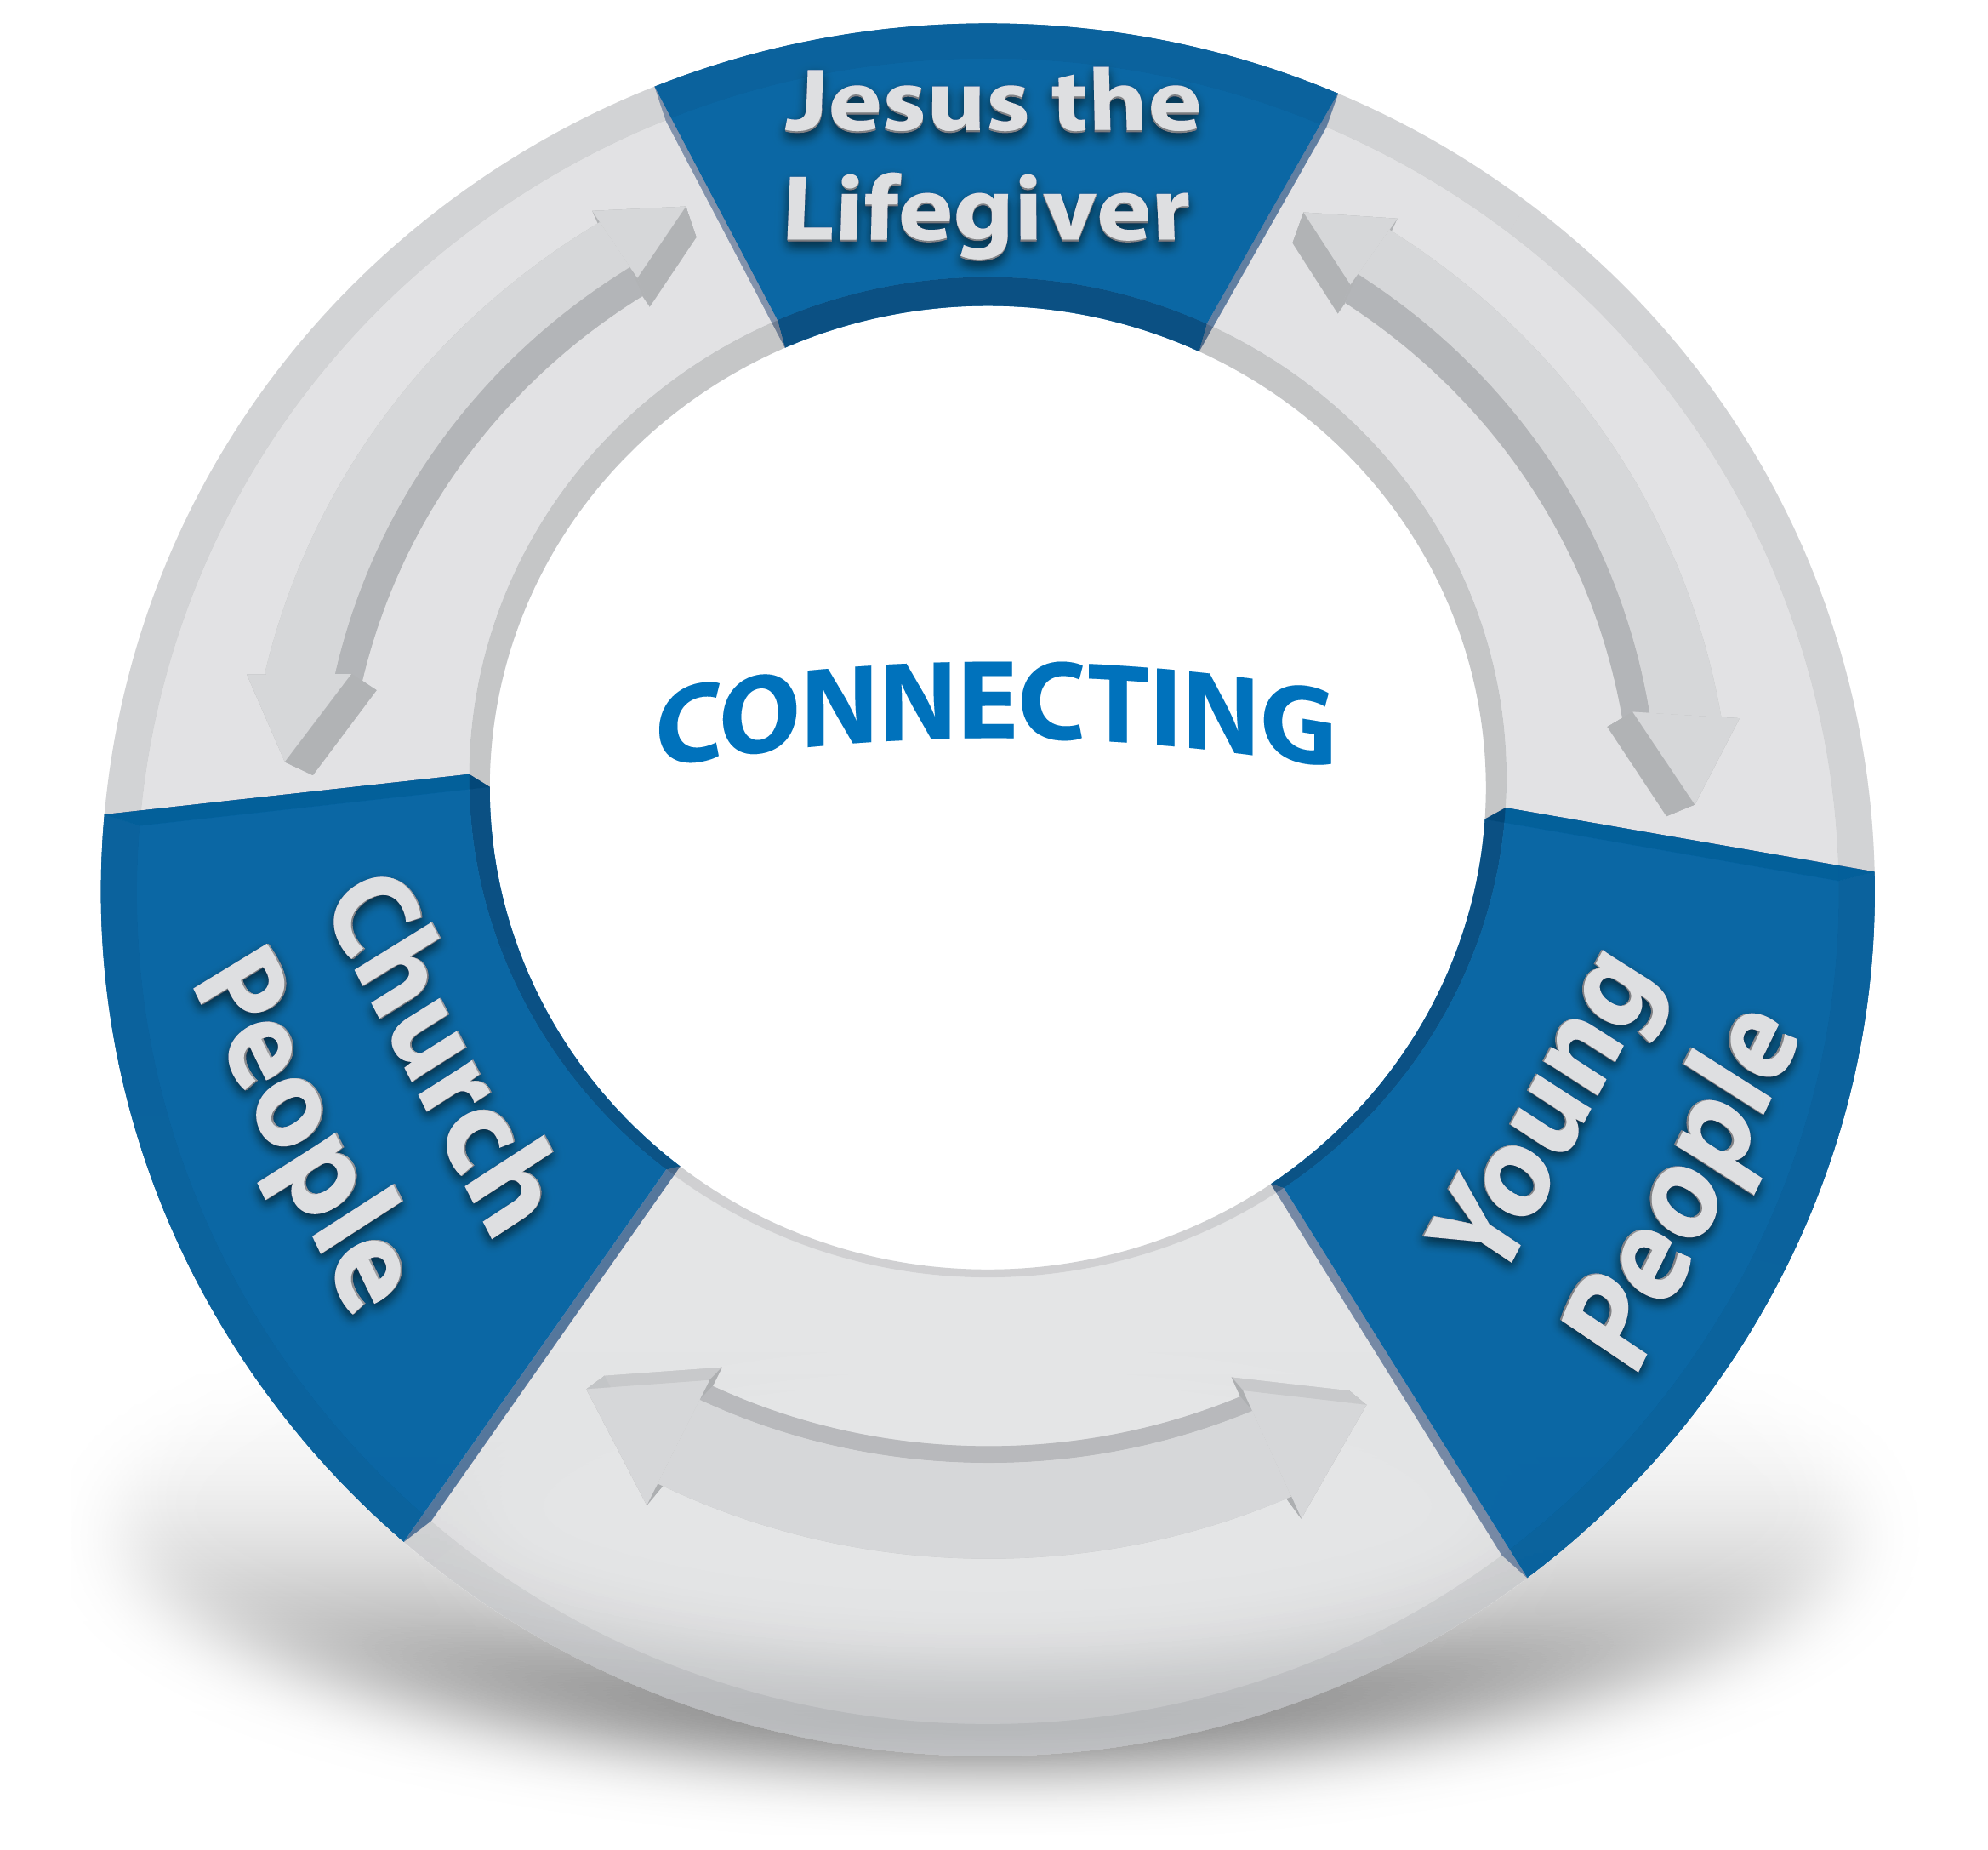

Slide 11
Announcing
Mission Lifeguard
Starting a Solution
Chapter 1
Start keeping a record
What are some ways you can keep
track of who is attending and missing
from your ministry?

Slide 12
Announcing
Mission Lifeguard
How it Works
Chapter 1
Basic Units for Mission Lifeguard
Spotters
Lifeguards
Resources

Slide 13

SPOTTERS
The SPOTTER is on the lookout for any youth or young adult who might be drowning or missing
A SPOTTER can be virtually any age
A SPOTTER should be good at record keeping and follow-up

Slide 14
SPOTTERS
What other characteristics do you think a
SPOTTER should have?
Can you identify who may make a good
SPOTTER in your ministry?

Slide 15

MISSION LIFEGUARDS
The LIFEGUARD connects with those who
are drowning or missing from church
The LIFEGUARD should have good
communication skills
A LIFEGUARD can be virtually any age

Slide 16

RESOURCES
The most important RESOURCES are people
Cooperating and coordinating ministry among
church increases the resources for your mission

Slide 17
Announcing
Mission Lifeguard
What you can do
Chapter 1
CPR
Connect
Praise
Release

Slide 18
“C” is for Connect
Announcing
Mission Lifeguard
Chapter 1
CONNECT with Jesus yourself so your relationship with God is vibrant
CONNECT with the Missing/Forgotten youth and young adults in church
CONNECT with your conference union, and division youth directors for resources support

Slide 19
“P” is for Praise
Announcing
Mission Lifeguard
Chapter 1
Praise God and celebrate when a young person is saved
Praise God and celebrate when a missing young person returns and begin their praise
Praise and celebrate with the returned young person at church continuously

Slide 20
“R” is for Release
Announcing
Mission Lifeguard
Chapter 1
Release the young person to take Jesus to others
Release young people to serve and then return for worship and fellowship
Release young people so young church is a spawning ground rather than a holding tank

