Slide 1
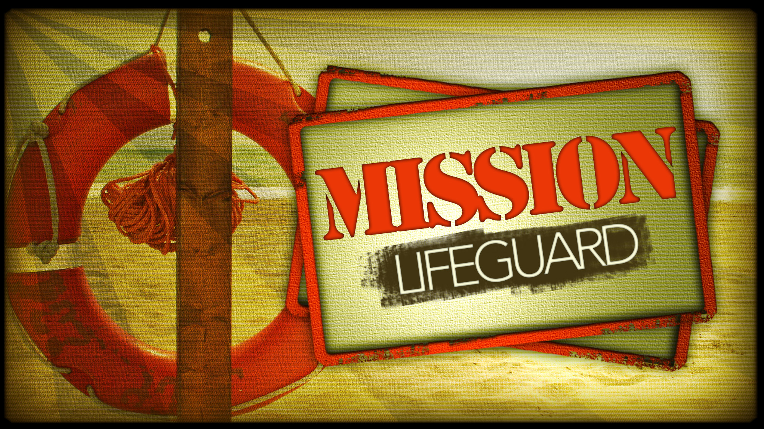

Slide 2

On the Lookout for
Spotters
Chapter 2

Slide 3


On the Lookout for
Spotters
The SPOTTER is on the
lookout for any youth or
young adult who might be
drowning or missing.
Chapter 2

Slide 4
On the Lookout for
Spotters
Making the List
Chapter 2
Who are the young people in
your church who may be drowning?
Who are the young people who no
longer attend your church?

Slide 5
On the Lookout for
Spotters
Clearing up Confusion
Chapter 2
What’s the difference between
SPOTTING and gossiping?
Does the “missing person” want to be
rescued by you, or the church?

Slide 6
What’s more important?
On the Lookout for
Spotters
Chapter 2
An individual or a group?
A believer or a congregation
Worship or fellowship?
My relationship with Christ or
my relationship with God’s people?
A missing person or missing church?

Slide 7

What’s missing from this
job description?
Commit to being a SPOTTER
Let others know of Your plans
Pray and ask others to join
you in prayer
Start a list of the drowning
or missing
Seek contact information
Pass along information to
the LIFEGUARD
Prepare your church to receive
young people
Continue to pray
Celebrate when a person is rescued
Celebrate when a person returns
Update your records
Repeat

Slide 8
Some tips on approaching
missing or lost people
On the Lookout for
Spotters
Chapter 2
Read Luke 15. How does God respond
to who is missing?

Slide 9
Some tips on approaching
missing or lost people
On the Lookout for
Spotters
Chapter 2
Don’t accuse or demean the missing
person. Rather, ask them to bring you
up to date on what’s going on.

Slide 10
Some tips on approaching
missing or lost people
On the Lookout for
Spotters
Chapter 2
Listen carefully to their story, instead of
Interjecting your story.

